Slide 1

Risk management practices in investment advisory
Sándor Szabó
29 February, 2024

Slide 2
Introduction – Sándor Szabó
Maalbeck Kft. • 1047 Budapest Attila utca 12–18., B. ép. fsz. 1. ajtó • +36 30 320 0387 • sandor.szabo@maalbeck.hu • www.maalbeck.hu
1992 - 1997 Budapest University of Economics MSC, specialization in Finance
1997 - 2006 Different treasury and corporate positions K&H, Citibank
2006 - 2009 Investor Relations Manager KBC, Brussels
2009 - 2016 Private Banking Head K&H
2017 - 2019 Private Banking Head MKB
2019 - 2023 Premium Banking Head, Deputy CEO SPB Investments Ltd
2023 - Business Development Head Creditexpert Ltd (NEXA Group)
Partner, Managing Director Maalbeck Investments Ltd (NEXA Group)

Slide 3
Introduction – Career stages related to investments
Maalbeck Kft. • 1047 Budapest Attila utca 12–18., B. ép. fsz. 1. ajtó • +36 30 320 0387 • sandor.szabo@maalbeck.hu • www.maalbeck.hu
1992 - 1997 Budapest University of Economics MSC, specialization in Finance
1997 - 2006 Different treasury and corporate positions K&H, Citibank
2006 - 2009 Investor Relations Manager KBC, Brussels
2009 - 2016 Private Banking Head K&H
2017 - 2019 Private Banking Head MKB
2019 - 2023 Premium Banking Head, Deputy CEO SPB Investments Ltd
2023 - Business Development Head Creditexpert Ltd (NEXA Group)
Partner, Managing Director Maalbeck Investments Ltd (NEXA Group)

Slide 4

Investment advisory is a risky business.. What others think about it..
Maalbeck Kft. • 1047 Budapest Attila utca 12–18., B. ép. fsz. 1. ajtó • +36 30 320 0387 • sandor.szabo@maalbeck.hu • www.maalbeck.hu

Slide 5
Investment advisory is a risky business.. What others think about it..
Maalbeck Kft. • 1047 Budapest Attila utca 12–18., B. ép. fsz. 1. ajtó • +36 30 320 0387 • sandor.szabo@maalbeck.hu • www.maalbeck.hu

Slide 6

Investment advisory is a risky business.. What others think about it..
Maalbeck Kft. • 1047 Budapest Attila utca 12–18., B. ép. fsz. 1. ajtó • +36 30 320 0387 • sandor.szabo@maalbeck.hu • www.maalbeck.hu

Slide 7

But the reality is..
Maalbeck Kft. • 1047 Budapest Attila utca 12–18., B. ép. fsz. 1. ajtó • +36 30 320 0387 • sandor.szabo@maalbeck.hu • www.maalbeck.hu

Slide 8

But the reality is..
Maalbeck Kft. • 1047 Budapest Attila utca 12–18., B. ép. fsz. 1. ajtó • +36 30 320 0387 • sandor.szabo@maalbeck.hu • www.maalbeck.hu

Slide 9

But the reality is..
Maalbeck Kft. • 1047 Budapest Attila utca 12–18., B. ép. fsz. 1. ajtó • +36 30 320 0387 • sandor.szabo@maalbeck.hu • www.maalbeck.hu

Slide 10
But investment advisory is really risky business, because..
Maalbeck Kft. • 1047 Budapest Attila utca 12–18., B. ép. fsz. 1. ajtó • +36 30 320 0387 • sandor.szabo@maalbeck.hu • www.maalbeck.hu
..the Provider is dealing with the Client’s money..
..not giving money to the Client but asking money from him / her..
and spending it, immediately..
But, „the Client decides”.. Indeed..

Slide 11
Risk management in practice Tools / Topics for discussion
Maalbeck Kft. • 1047 Budapest Attila utca 12–18., B. ép. fsz. 1. ajtó • +36 30 320 0387 • sandor.szabo@maalbeck.hu • www.maalbeck.hu
Legal background (MIFID et co)
Education
Product-selection
Portfolio-building
Diversification
Controls

Slide 12
Investment services The legal background
Maalbeck Kft. • 1047 Budapest Attila utca 12–18., B. ép. fsz. 1. ajtó • +36 30 320 0387 • sandor.szabo@maalbeck.hu • www.maalbeck.hu
Dedicated law on investment providers
Dedicated guarantee-fund: BEVA - National Investment Protection Fund
Provides guarantee up to EUR 100k per client per institution automatically
Individual decisions above that limit
Regulatory authority: National Bank of Hungary
European regulatory framework: MIFID-legislation

Slide 13
Investment services Products
Maalbeck Kft. • 1047 Budapest Attila utca 12–18., B. ép. fsz. 1. ajtó • +36 30 320 0387 • sandor.szabo@maalbeck.hu • www.maalbeck.hu
Cash Non-financial assets
Banking deposits Gold, Real estates
Crypto currencies
Securities
Treasury Bonds, Treasury Bills
Corporate Bonds
Shares
Investment Funds, ETFs
etc

Slide 14
Investment services Service-types
Maalbeck Kft. • 1047 Budapest Attila utca 12–18., B. ép. fsz. 1. ajtó • +36 30 320 0387 • sandor.szabo@maalbeck.hu • www.maalbeck.hu
Broking services
Investment advisory
Portfolio management

Slide 15
Investment services Broking services (execution only services)
Maalbeck Kft. • 1047 Budapest Attila utca 12–18., B. ép. fsz. 1. ajtó • +36 30 320 0387 • sandor.szabo@maalbeck.hu • www.maalbeck.hu
The Provider does not provide advice, but trading platform and market info for the Client
Market info vs investment advice
The investment advice considers the Client’s financial status and risk-appetite
The market info is solely about the product and / or the market
Decisions made by the Client
Quick and cheap
Mainly online platforms
Even without a human interface (between the Client and the Provider)

Slide 16
Investment services Investment advisory
Maalbeck Kft. • 1047 Budapest Attila utca 12–18., B. ép. fsz. 1. ajtó • +36 30 320 0387 • sandor.szabo@maalbeck.hu • www.maalbeck.hu
Investment advice based on the financial situation and risk-taking capabilities of the Client
Transactions based on the advice, but following the Client’s documented consent only
The Client has the sole right to decide, either:
to accept the proposal fully, or
to accept the proposal partially, or
to refuse the proposal
The advice and the transaction are equally weighted from regulatory point of view

Slide 17
Investment services Portfolio management
Maalbeck Kft. • 1047 Budapest Attila utca 12–18., B. ép. fsz. 1. ajtó • +36 30 320 0387 • sandor.szabo@maalbeck.hu • www.maalbeck.hu
Investment policy defined in line with the Client’s financial situation and risk-taking capabilities
Transactions done within the pre-defined frame set by the investment policy
No need for the Client’s approval for every single decisions, but regular reporting provided

Slide 18
Investment services Know Your Client AND Know Your Market
Maalbeck Kft. • 1047 Budapest Attila utca 12–18., B. ép. fsz. 1. ajtó • +36 30 320 0387 • sandor.szabo@maalbeck.hu • www.maalbeck.hu
A good banker at the same time:
knows his / her Client AND the market,
is available for the Clients AND follows-up the markets,
earns yield for the Client AND revenue for the Provider
builds portfolios AND manages risks
Different tasks require different competences
..therefore we must split tasks between different colleagues

Slide 19
Investment services Split of tasks
Maalbeck Kft. • 1047 Budapest Attila utca 12–18., B. ép. fsz. 1. ajtó • +36 30 320 0387 • sandor.szabo@maalbeck.hu • www.maalbeck.hu
Banker-tasks:
Relationship-management with the Clients
Understanding the Client’s background and motivations
Preparing investment advices and related materials
Client-education
Trading
Administration

Slide 20
Investment services Split of tasks
Maalbeck Kft. • 1047 Budapest Attila utca 12–18., B. ép. fsz. 1. ajtó • +36 30 320 0387 • sandor.szabo@maalbeck.hu • www.maalbeck.hu
Analyst-tasks:
Being on the market
Reading and preparing analyses
Representing the Provider’s strategic targets
Preparing of target-portfolios, follow-up
Market-risk management
Banker-education

Slide 21
Regulatory approach Asymmetric information
Maalbeck Kft. • 1047 Budapest Attila utca 12–18., B. ép. fsz. 1. ajtó • +36 30 320 0387 • sandor.szabo@maalbeck.hu • www.maalbeck.hu
Basic regulatory principles:
The Provider is on the market – contrary to the Client
The Provider has all necessary information for preparing a proper advice
The Client is ready and capable to adsorb all information he/she gets from the Provider
Therefore the Provider should investigate, whether:
Is the Client suitable for the proposed portfolio?
Is the proposed portfolio in line with the Client’s risk-appetite and risk-taking capabilities?
The tool for the investigation: the MIFID-test

Slide 22

A bit of history Where does this regulatory approach come from?
Maalbeck Kft. • 1047 Budapest Attila utca 12–18., B. ép. fsz. 1. ajtó • +36 30 320 0387 • sandor.szabo@maalbeck.hu • www.maalbeck.hu

Slide 23
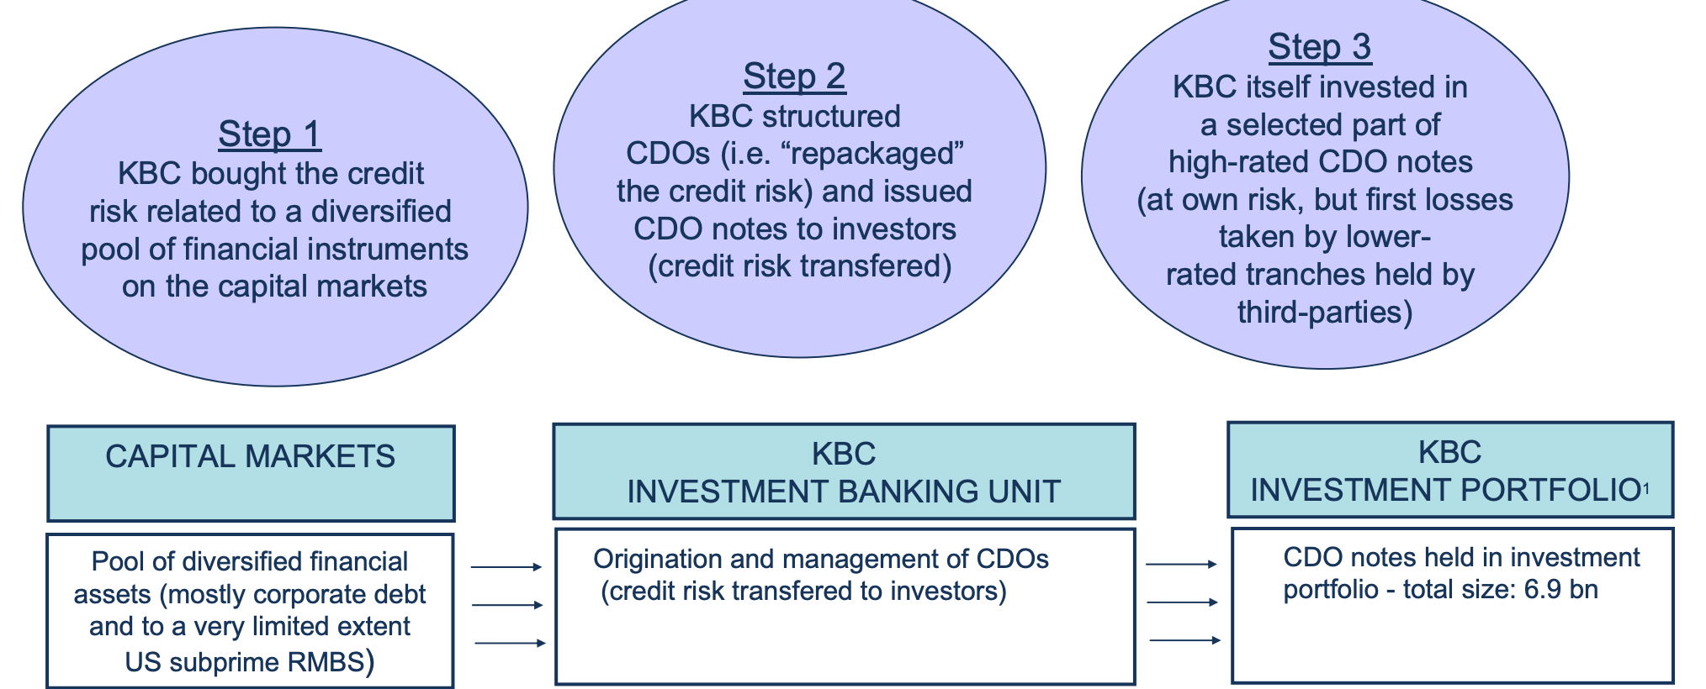
CDOs Collateralized Debt Obligations
Maalbeck Kft. • 1047 Budapest Attila utca 12–18., B. ép. fsz. 1. ajtó • +36 30 320 0387 • sandor.szabo@maalbeck.hu • www.maalbeck.hu

Slide 24
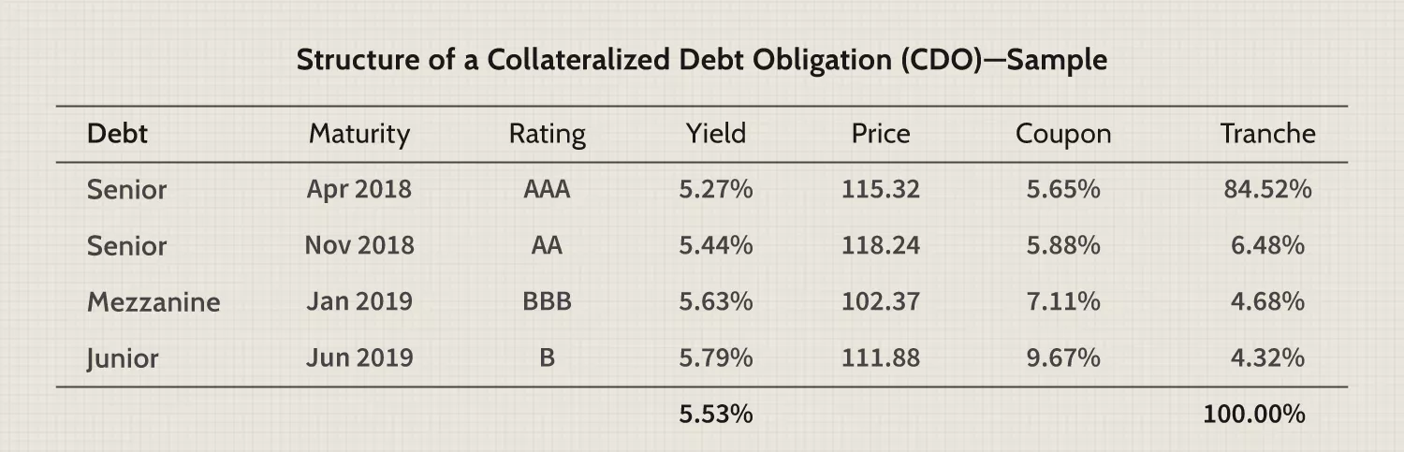
CDOs General principles
Maalbeck Kft. • 1047 Budapest Attila utca 12–18., B. ép. fsz. 1. ajtó • +36 30 320 0387 • sandor.szabo@maalbeck.hu • www.maalbeck.hu

Slide 25
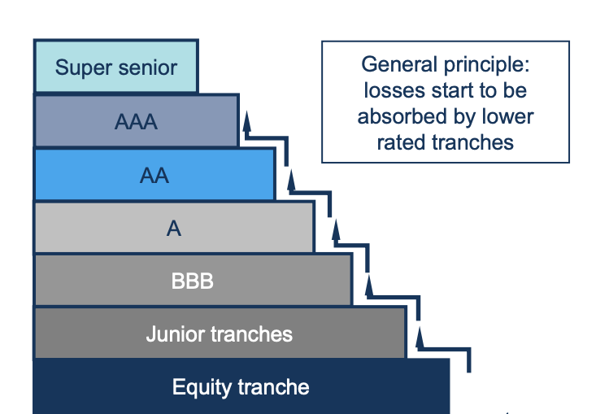
CDOs Loss adsorption
Maalbeck Kft. • 1047 Budapest Attila utca 12–18., B. ép. fsz. 1. ajtó • +36 30 320 0387 • sandor.szabo@maalbeck.hu • www.maalbeck.hu
Losses are dependent on the structure of “loss distribution” between CDO tranches.
The higher the rating class, the lower the loss.
Higher-rated tranches are less vulnerable, since loss absorption starts at lower-rated tranches
Source: https://www.kbc.com/content/dam/kbccom/doc/investor-relations/4-Presentations/200803_Debt_Investor_en.pdf

Slide 26
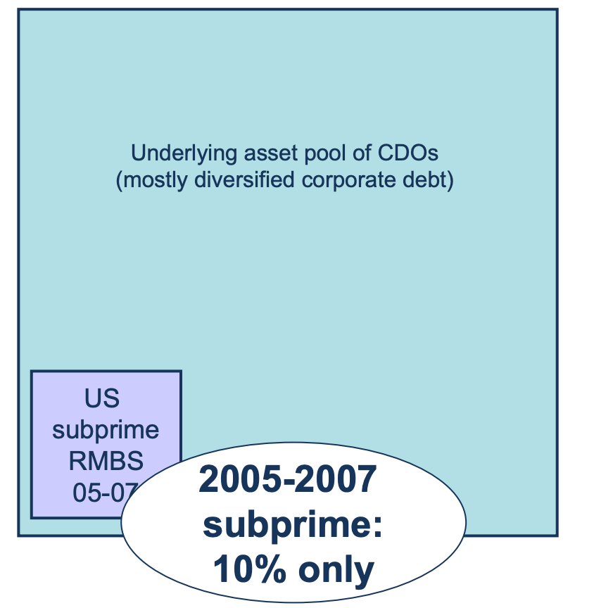
CDOs CDOs with subprime exposure
Maalbeck Kft. • 1047 Budapest Attila utca 12–18., B. ép. fsz. 1. ajtó • +36 30 320 0387 • sandor.szabo@maalbeck.hu • www.maalbeck.hu
Subprime related losses are dependent on the share of ‘US subprime mortgages’ within the pool of underlying assets (esp. those written in the 2005-2007 period).
The lower the level of 2005-2007 subprime mortgages, the lower the loss
Source: https://www.kbc.com/content/dam/kbccom/doc/investor-relations/4-Presentations/200803_Debt_Investor_en.pdf

Slide 27


But what subprime is? The Big Short continued..
Maalbeck Kft. • 1047 Budapest Attila utca 12–18., B. ép. fsz. 1. ajtó • +36 30 320 0387 • sandor.szabo@maalbeck.hu • www.maalbeck.hu
https://www.youtube.com/watch?v=xZTFNizSNGs

Slide 28
CDOs CDS – Credit Default Swap
Maalbeck Kft. • 1047 Budapest Attila utca 12–18., B. ép. fsz. 1. ajtó • +36 30 320 0387 • sandor.szabo@maalbeck.hu • www.maalbeck.hu
A synthetic CDO is a type of collateralized debt obligation (CDO) that invests in noncash assets that can offer extremely high yields to investors.
However, they differ from traditional CDOs, which typically invest in regular debt products such as bonds, mortgages, and loans, in that they generate income by investing in noncash derivatives such as credit default swaps (CDSs), options, and other contracts.
Synthetic CDOs are typically divided into credit tranches based on the level of credit risk assumed by the investor.

Slide 29

CDS – Credit Default Swap The Big Short continued..
Maalbeck Kft. • 1047 Budapest Attila utca 12–18., B. ép. fsz. 1. ajtó • +36 30 320 0387 • sandor.szabo@maalbeck.hu • www.maalbeck.hu

Slide 30
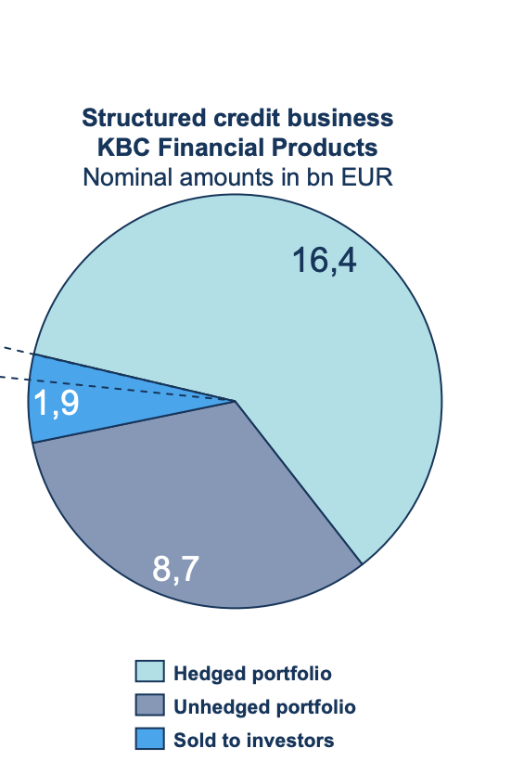
CDOs Why is this story interesting for us today?
Maalbeck Kft. • 1047 Budapest Attila utca 12–18., B. ép. fsz. 1. ajtó • +36 30 320 0387 • sandor.szabo@maalbeck.hu • www.maalbeck.hu
Total amount of KBC FP generated CDO business: 27.1bn, of which:
16.4bn hedged with third parties (“hedged portfolio”)
8.7bn own investment portfolio (“unhedged portfolio”)
1.9bn sold to investors, largely institutional profile, of which
Approx. 0.6bn has been sold to Private Banking clients
Forrás: https://www.kbc.com/content/dam/kbccom/doc/investor-relations/4-Presentations/200803_Debt_Investor_en.pdf

Slide 31
Regulatory approach Asymmetric information
Maalbeck Kft. • 1047 Budapest Attila utca 12–18., B. ép. fsz. 1. ajtó • +36 30 320 0387 • sandor.szabo@maalbeck.hu • www.maalbeck.hu
Lessons learnt by the regulators from the 2008-crisis (and from the CDO-cases, amongst others):
The Provider is on the market – contrary to the Client
The Provider has all necessary information for preparing a proper advice
Conclusions drawn from leading to the introduction of the so-called MIFID-regime on European level

Slide 32
The MIFID-test The purposes of the test – understanding the Client
Maalbeck Kft. • 1047 Budapest Attila utca 12–18., B. ép. fsz. 1. ajtó • +36 30 320 0387 • sandor.szabo@maalbeck.hu • www.maalbeck.hu
Understanding his/her general financial situation
Understanding the planned investment portfolio in light of his/her general financial situation
Understanding his/her approach towards to risks and returns
Understanding his/her financial knowledge
+1: Client-education

Slide 33
Client education Risks involved in investments
Maalbeck Kft. • 1047 Budapest Attila utca 12–18., B. ép. fsz. 1. ajtó • +36 30 320 0387 • sandor.szabo@maalbeck.hu • www.maalbeck.hu
Market risk
Inflation risk
Interest rate risk
FX-risk
Country risk
Issuer risk
Operational risk
Fraud risk

Slide 34
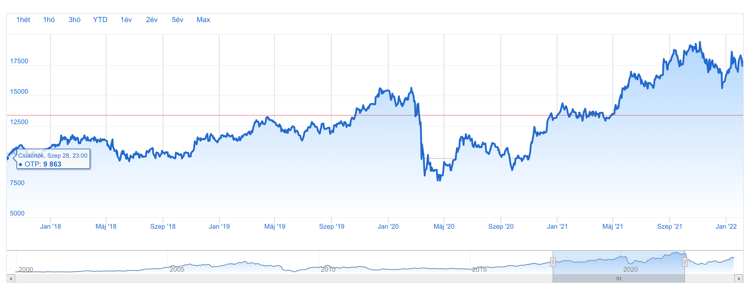
Client education Risk vs return
Maalbeck Kft. • 1047 Budapest Attila utca 12–18., B. ép. fsz. 1. ajtó • +36 30 320 0387 • sandor.szabo@maalbeck.hu • www.maalbeck.hu
Which one was the better investment? OTP share or 2023/J T-Bond?
OTP
Sept 29, 2023:
HUF 13.380
OTP
Sept 29, 2018
HUF 9.863

Slide 35
Client education The targeted level of understanding
Maalbeck Kft. • 1047 Budapest Attila utca 12–18., B. ép. fsz. 1. ajtó • +36 30 320 0387 • sandor.szabo@maalbeck.hu • www.maalbeck.hu
The Client should understand two main principles:
1. The only risk he/she should bear is the unpredictability of the return, or with other words: the market risk
The yield could be positive, or negative, but the total invested capital never will be lost
2. Risk/return relation: As high risk he/she is ready to take as high return he/she can expect
Our tool for getting there together with the Client is the MIFID-test

Slide 36
The MiFID test Group exercise (15’)
Maalbeck Kft. • 1047 Budapest Attila utca 12–18., B. ép. fsz. 1. ajtó • +36 30 320 0387 • sandor.szabo@maalbeck.hu • www.maalbeck.hu
Form groups with 3 members in each
Prepare a questionnaire based on the following topics:
Products
Investment experiences
Investment horizon (timeline)
Expectations, targets
Sustainability
Manage 3 interviews per group and classify the “Clients” into different risk-levels based on the results
Low
Average
High

Slide 37
The MiFID test in practice Investment experiences
Maalbeck Kft. • 1047 Budapest Attila utca 12–18., B. ép. fsz. 1. ajtó • +36 30 320 0387 • sandor.szabo@maalbeck.hu • www.maalbeck.hu
Which product have you ever had in your portfolio?
Bank deposit
Treasury Bond
Corporate Bond
Investment Fund / ETF
Share
Structured product
Warrant
Certificate
Options
None of the above

Slide 38
The MiFID test in practice Investment experiences
Maalbeck Kft. • 1047 Budapest Attila utca 12–18., B. ép. fsz. 1. ajtó • +36 30 320 0387 • sandor.szabo@maalbeck.hu • www.maalbeck.hu
Which product have you heard about already?
Bank deposit
Treasury Bond
Corporate Bond
Investment Fund / ETF
Share
Structured product
Warrant
Certificate
Options
None of the above

Slide 39
The MiFID test in practice Investment experiences
Maalbeck Kft. • 1047 Budapest Attila utca 12–18., B. ép. fsz. 1. ajtó • +36 30 320 0387 • sandor.szabo@maalbeck.hu • www.maalbeck.hu
How do you evaluate the level of your financial knowledge?
a. low b. average c. high
How many transactions do you manage per year?
a. 0-10 transactions
b. 11-50 transactions
c. more than 50

Slide 40
The MiFID test in practice Investment experiences
Maalbeck Kft. • 1047 Budapest Attila utca 12–18., B. ép. fsz. 1. ajtó • +36 30 320 0387 • sandor.szabo@maalbeck.hu • www.maalbeck.hu
What is your average ticket-size?
a. HUF 0-500k b. HUF 500k – HUF 5m
c. HUF 5m – HUF 20m d. HUF 50m+
What is the average duration of your investment transactions?
a. short (0-1 year) b. mid (1-3 years)
c. long (3 years+) d. flexible

Slide 41
The MiFID test in practice Risk appetite
Maalbeck Kft. • 1047 Budapest Attila utca 12–18., B. ép. fsz. 1. ajtó • +36 30 320 0387 • sandor.szabo@maalbeck.hu • www.maalbeck.hu
Are you ready to take higher risk to reach higher return?
a. I am aware that in order to reach higher return higher risk should be taken, even with leveraging my original capital. I am ready to take higher risk and to finance additional capital, if needed
b. I am aware that in order order to reach a higher return higher risk should be taken, but I am not ready to take leverage in my portfolio. I am ready to risk just a smaller part of my portfolio
c. I am aware that in order order to reach a higher return higher risk should be taken, but I am interested in low-risk products only

Slide 42
The MiFID test in practice Financial targets
Maalbeck Kft. • 1047 Budapest Attila utca 12–18., B. ép. fsz. 1. ajtó • +36 30 320 0387 • sandor.szabo@maalbeck.hu • www.maalbeck.hu
For how long do you plan to hold your investments?
1 year b. 1-3 years c. 3-5 years d. 5 years+
What is the purpose / purposes of your investments?
savings b. speculation c. retirement d. other

Slide 43
The MiFID test in practice Financial situation
Maalbeck Kft. • 1047 Budapest Attila utca 12–18., B. ép. fsz. 1. ajtó • +36 30 320 0387 • sandor.szabo@maalbeck.hu • www.maalbeck.hu
How much savings can you take per a month?
HUF 0-100k b. HUF 100k – 500k c. HUF 500k+ d. varies
Where do you get your earnings from
salary b. other
Do you have any financial obligation?
yes b. no

Slide 44
The MiFID test in practice Knowledge, ESG
Maalbeck Kft. • 1047 Budapest Attila utca 12–18., B. ép. fsz. 1. ajtó • +36 30 320 0387 • sandor.szabo@maalbeck.hu • www.maalbeck.hu
Do you have financial educational background?
yes b. no
Do you have any ESG-preferences?
Yes b. no

Slide 45
The MiFID test in practice Evaluation of the results
Maalbeck Kft. • 1047 Budapest Attila utca 12–18., B. ép. fsz. 1. ajtó • +36 30 320 0387 • sandor.szabo@maalbeck.hu • www.maalbeck.hu
Based on the results the Client should be classified as a low-/average-/high-risk client
Not only the Clients, but the products are classified as low-/average-/high risk-products
As the result of the investment advice the average risk-level of the proposed portfolio shouldn’t exceed the risk-level of the Client (investment advisory)
In case of portfolio-management services the investment policy should be aligned with the risk-category of the Client

Slide 46
The MiFID test in practice Evaluation of the results
Maalbeck Kft. • 1047 Budapest Attila utca 12–18., B. ép. fsz. 1. ajtó • +36 30 320 0387 • sandor.szabo@maalbeck.hu • www.maalbeck.hu
Additional product-limitations could be applied as well
Risk-limitations apply for the advice only, the Client is allowed to deviate at any time (execution-only)
ESG-compliancy should be double-checked separately
+1: Everything should be strictly documented

Slide 47
The MiFID test in practice Product risk-categories
Maalbeck Kft. • 1047 Budapest Attila utca 12–18., B. ép. fsz. 1. ajtó • +36 30 320 0387 • sandor.szabo@maalbeck.hu • www.maalbeck.hu
Cash Low risk (C) Risk scoring: 1
Treasury Bond Low risk (C)
Capital guaranteed certificate Low risk (C)
Corporate Bond Average risk (B) Risk scoring: 2
ETF / investment fund w/o leverage Average risk (B)
Shares Average risk (B)
Certificate w/o capital-guarantee Average risk (B)
Other derivative products High risk (A) Risk scoring: 3
ETF / investment fund with leverage High risk (A)

Slide 48
Controls Portfolio-building rules and limitations
Maalbeck Kft. • 1047 Budapest Attila utca 12–18., B. ép. fsz. 1. ajtó • +36 30 320 0387 • sandor.szabo@maalbeck.hu • www.maalbeck.hu
MiFID-compliancy
The weighted risk-average of the Client’s portfolio shouldn’t exceed the Client’s risk-level
Risk categories based on the average risk scores
Average scoring: 1 – 1.5 Category: MIFID „C” (low)
Average scoring: 1.51 – 2 Category: MIFID „B” (average)
Average scoring: 2.01 - 3 Category: MIFID „C” (high)
Product-limitations apply (examples):
Low-risk Client shouldn’t get shares, or certificate w/o capital-guarantee

Slide 49
Controls Portfolio-building rules and limitations
Maalbeck Kft. • 1047 Budapest Attila utca 12–18., B. ép. fsz. 1. ajtó • +36 30 320 0387 • sandor.szabo@maalbeck.hu • www.maalbeck.hu
Issuer limit
Maximum weight of a given issuer: 25% (except for ETFs, investment funds)
Sector limit
Maximum weight of a given sector: 50% (except: “Mixed”, or “Sovereign”)
Regional limit
Maximum weight of a given geographic region: 50% (except: “Global”, or “North-America”)
Maturity limit
Maximum weight of bonds and T-bonds with 15 years+ remaining maturity: 50%

Slide 50
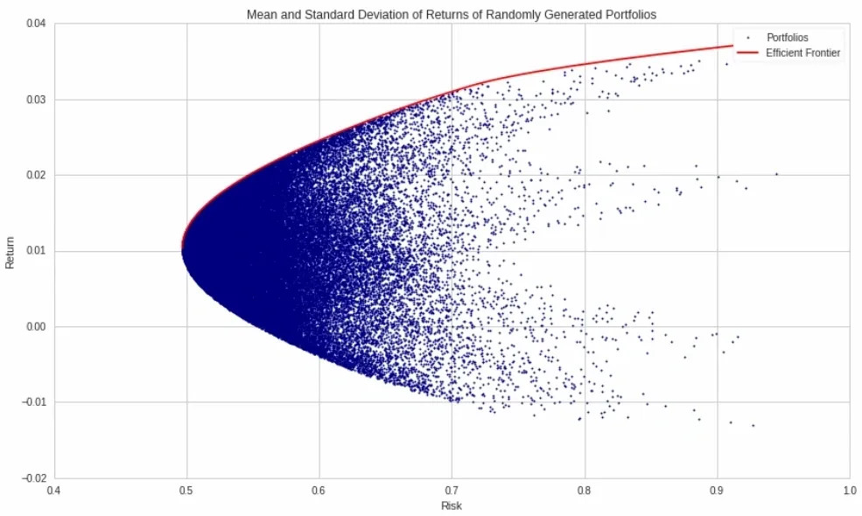
Risk management in practice Diversification
Maalbeck Kft. • 1047 Budapest Attila utca 12–18., B. ép. fsz. 1. ajtó • +36 30 320 0387 • sandor.szabo@maalbeck.hu • www.maalbeck.hu
The most important market tool of risk management tool is the diversification – the Markowitz-model

Slide 51
Risk management in practice Diversification - Group exercise (15’)
Maalbeck Kft. • 1047 Budapest Attila utca 12–18., B. ép. fsz. 1. ajtó • +36 30 320 0387 • sandor.szabo@maalbeck.hu • www.maalbeck.hu
What are the main dimensions you would propose to use for portfolio-diversification purposes?
Based on what criteria would you split a given portfolio?
What are the main differences between a low-/ an average-/ and a high-risk portfolio?
Proposal: use the same dimensions for the diversification we’ve just discussed:
Investment horizon
Regions, markets
Sectors, topics
Investment tools (Products)
Currency
Issuer

Slide 52
Risk management in practice Diversification – A target portfolio
Maalbeck Kft. • 1047 Budapest Attila utca 12–18., B. ép. fsz. 1. ajtó • +36 30 320 0387 • sandor.szabo@maalbeck.hu • www.maalbeck.hu
DIMENSION / SUB-PORTFOLIO | CORE | OPTIONAL CORE | SATELITE
Investment horizon | 2-3 years | 1-1.5 years | 1-3 months
Market / sector / topic | Global bond market, Global equity market | ESG Cybersecurity Defense sector | Undervalued shares, bonds
Region | US / global | US / global / EU | US / EU / Hungary
Products | ETF, capital guaranteed certificate | ETF, certificate w/o capital guarantee | Individual shares, bonds
Weight | 0-40% | 0-60% | 0-30%
Preferred currency | USD | USD, EUR | USD, HUF

Slide 53
Questions? Answers!

Slide 54
Thanks for your attention!
Sándor Szabó
sandor.szabo@maalbeck.hu
+36 30 320 0387

